Slide 1
Lecture 25

Slide 2
Question 14.4.1
In which state of matter are the atoms that make up the matter most tightly bound by electrical forces?
Solid
Liquid
Gas
Plasma

Slide 3
m
m
m
m
m
m
m
m
m
m
m
m
m
m
m
m
m
m
m
m
m
m
m
m

Slide 4
m
m
m
m
m
m
m
m
m
m
m
m
m
m
m
m
m
m

Slide 5
m
m
m
m
m
m
m

Slide 6
m
m
m
m
m
m

Slide 7
Fluid Mechanics
Fluids: Randomly arranged collections of molecules
Gases
Liquids
Solids?
No shearing stresses
No Tensile stresses

Slide 8
Question 123.4.2
Suppose you are standing directly behind someone who steps back and accidentally stomps on your foot with the heel of one shoe. Would you be better off if that person were
(a) a large professional basket ball player wearing sneakers
(b) a petite woman wearing spike-heeled shoes?

Slide 9
Question 123.4.3
Consider what happens when you push both a pin and the blunt end of a pen against your skin with the same force. What will determine whether your skin will be punctured?
a) the pressure on your skin
b) the net applied force on your skin
c) both pressure and net applied force are equivalent
d) neither pressure nor net applied force are relevant here
G

Slide 10
Problem
A 50.0kg woman balances on one heel of a pair of high heeled shoes. If the heel is circular and has a radius of 0.5000cm , what pressure does she exert on the floor?

Slide 11
Problem
How much larger is the pressure at the bottom of a swimming pool than the pressure at the pool surface?

Slide 13
F_{pml}
F_{pmr}
F_{pt}
W
F_{pb}

Slide 14
F_{pt}
F_{pml}
F_{pmr}
W
F_{pb}

Slide 15
P_{m}A_{side} x
P_{t}Ay
P_{m}A_{side} x
P_{m}A x
Mg
P_{b}Ay

Slide 16
P_{t}A
d
d+h
Mg
P_{b}A

Slide 17

Δ$y$

Slide 18
F_{pml}
-F_{pmr}
F_{pt}
W
F_{pb}

Slide 19
d+h
d
dy
h

Slide 20
Question 123.4.5
Two dams are exactly the same size (same width and depth). One (A) holds back a large lake, the other (B) holds back a small river. Which Dam has to be built stronger?
A
B
Neither, they should be the same
A
To Sugar City
Dam
B

Slide 21

P_{t}
dy
P_{b}

Slide 22
Question 123.4.9
When a hole is made in the side of a can holding fluid, the fluid flows out of the hole. The path the water follows is shown in the picture. If the container is dropped in free fall, the water flow will:
a) diminish
b) stop altogether
c) go out in a straight line
d) curve upwards

Slide 23
Question 123.5.1
P=0
If the barometer shown here were used on Mars, would h be larger or smaller
Larger
Smaller
h
P_{o}

Slide 24
P_{t} = 0
P_{t} = P_{atm}
h
A
B

Slide 25
Pressure Measurement: Barometer
P_{t} = 0
In many pressure measurements, the idea is to make the pressure due to a column of fluid equal to the pressure to be measured
For the barometer,
We solve for the height of the liquid (usually Hg)
Would a water be practical to use for a barometer?
P_{t} = P_{atm}
h
A
B

Slide 26
Pressure Measurement: Barometer
P_{t} = 0
In many pressure measurements, the idea is to make the pressure due to a column of fluid equal to the pressure to be measured
For the barometer,
We solve for the height of the liquid.
For water this would be
P_{t} = P_{atm}
h
A
B

Slide 27

Question 123.5.2
The pressure at point A in this monometer is ________ the pressure at point B
higher than
lower than
the same as
Pipe with a higher pressure, P_{pipe} that we wish to measure
Δh
A
B
P_{A}
P_{B}

Slide 28
Pipe with a higher pressure, P_{pipe} that we wish to measure
Δh
A
B
P_{A}
P_{B}

Slide 29
END

Slide 30
Question 123.4.4
You are walking out on a frozen lake and you begin to hear the ice cracking beneath you. What is your best strategy for getting off the ice safely?
a) stand absolutely still and don’t move a muscle
b) jump up and down to lessen your contact time with the ice
c) try to leap in one bound to the bank of the lake
d) shuffle your feet (without lifting them) to move towards shore
e) lie down flat on the ice and crawl toward shore
G

Slide 31
Question 123.4.6
Which has a greater force do to the fluid acting on the base?
A B
Hint: Which has a greater total weight?
Lead

Slide 32
Pressure and Depth (2 of 3)
-F_{pt}
F_{pml}
-F_{pmr}
If we use our new definition of pressure
F_{pb}
W
Sides
-P_{o}Aĵ
Top
P_{m}A x
-P_{m}A x
Bottom
PAĵ
Mg

Slide 33
Pressure and Depth (3 of 3)
Substitution yields:
So we find that the pressure as a function of depth is given by
If we start at the surface,
-P_{o}Aĵ
d
d+h
PAĵ
Mg

Slide 34
Pascal’s Law
If we change P_{o}, there must be a change in pressure throughout the entire fluid!
Pascal’s Law: a change in the pressure applied to a fluid is transmitted undiminished to every point of the fluid and to the walls of the container.

Slide 35
Question 123.4.7
Three containers are filled with water to the same height and have the same surface area at the base, but the total weight of water is different for each. Which container has the greatest total force acting on its base?
a) container 1
b) container 2
c) container 3
d) all three are equal
1
2
3

Slide 36
Question 123.4.8
How do Hydraulic Brakes Work?
A) The pressure due to the pedal being depressed compresses the fluid which then causes a force on the the brake pads
B) The force due to the pedal being depressed increases the pressure which is transmitted equally to the entire system, and causes a force on the brake pads
C) The force on the pedal causes a change in volume of the master cylinder which, in turn, causes there to be a higher pressure in the brake cylinder than exists in the master cylinder. This higher pressure causes a force on the brake pads

Slide 37
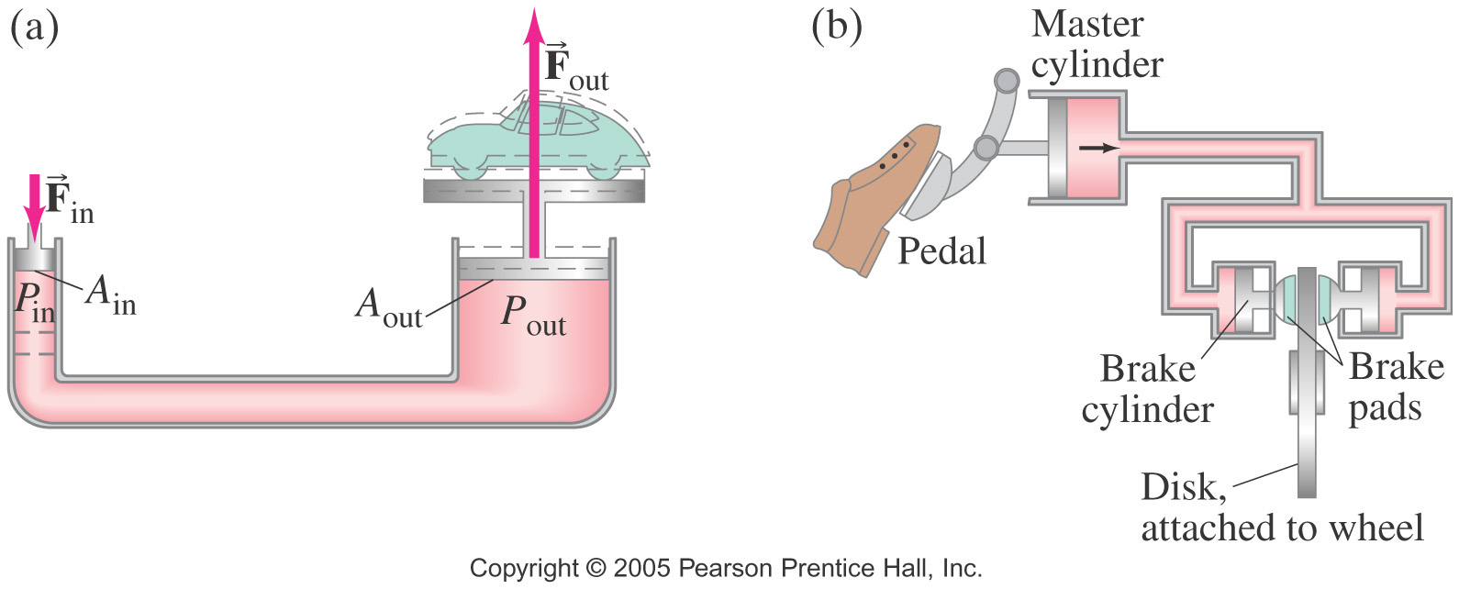
Question 123.4.8
How do Hydraulic Brakes Work?
A) The pressure due to the pedal being depressed compresses the fluid which then causes a force on the the brake pads
B) The force due to the pedal being depressed increases the pressure which is transmitted equally to the entire system, and causes a force on the brake pads
C) The force on the pedal causes a change in volume of the master cylinder which, in turn, causes there to be a higher pressure in the brake cylinder than exists in the master cylinder. This higher pressure causes a force on the brake pads

Slide 38
Problem
We push down on the small piston on the left. The pressure changes by an amount ΔP. How much does the pressure change in the right hand side of this jack?

Slide 39
Problem
We push down on the small piston on the left. The pressure changes by an amount ΔP. What is the upward force in the right hand side of the jack?

Slide 40
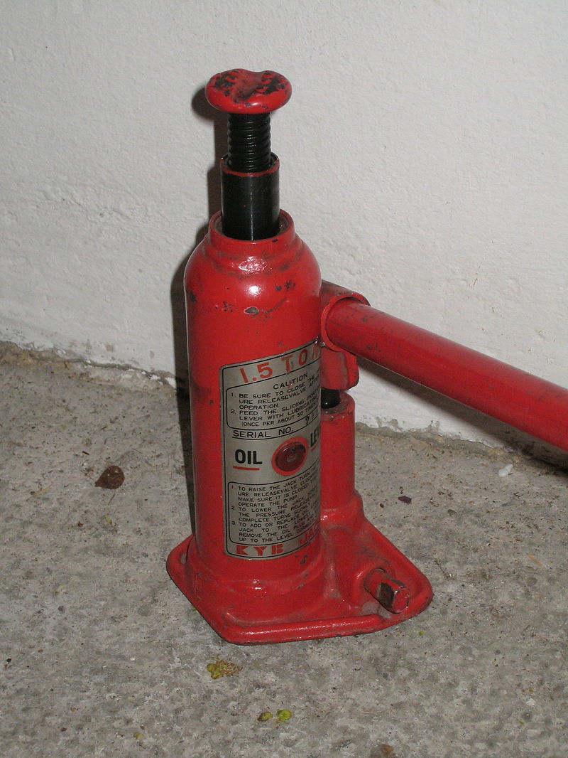
Small Cylinder
Big Cylinder

Slide 41
Question 123.5.1
P=0
If the barometer shown here were used on Mars, would h be larger or smaller
Larger
Smaller
h
P_{o}

Slide 42
Question 123.5.2
The pressure at point A in this monometer is ________ the pressure at point B
higher than
lower than
the same as
Pipe with a higher pressure, P_{pipe} that we wish to measure
Δh
A
B
P_{A}
P_{B}

Slide 43
P_{t} = 0
P_{t} = P_{atm}
h
A
B

Slide 44
Pressure Measurement: Barometer
P_{t} = 0
In many pressure measurements, the idea is to make the pressure due to a column of fluid equal to the pressure to be measured
For the barometer,
We solve for the height of the liquid (usually Hg)
Would a water be practical to use for a barometer?
P_{t} = P_{atm}
h
A
B

Slide 45
Pressure Measurement: Barometer
P_{t} = 0
In many pressure measurements, the idea is to make the pressure due to a column of fluid equal to the pressure to be measured
For the barometer,
We solve for the height of the liquid.
For water this would be
P_{t} = P_{atm}
h
A
B

Slide 46
Pipe with a higher pressure, P_{pipe} that we wish to measure
Δh
A
B
P_{A}
P_{B}

Slide 48
Question 123.5.3
Take a beach ball sized parcel of water. What happens if we replace the parcel with the beach ball?
The ball will rise because it is less dense than the water
The ball will rise because the buoyant force will be larger for the beach ball
The ball will rise because it’s surface area will be different than the parcel of water
B
F_{g}

Slide 49
Question 123.5.3.5
We say that there is a buoyant force acting on the beach ball. What is the buoyant force?
It is the net force on the beach ball
It is the net force due to the water pressure acting on the beach ball
It is a force that makes things float at the surface
50

Slide 50
Buoyant Forces
Remember from
a stationary parcel of water there is a force that balances the weight of the parcel
Forces that act in the x-direction (sideways) balance each other
-P_{o}Aĵ
P_{m}A x
-P_{m}A x
j
PAĵ
i
Mg

Slide 51
Buoyant Forces
Now take a beach ball sized parcel of water
There is a force due to gravity and a force due to the pressure
What happens if we replace the parcel with the beach ball?
B
W

Slide 52
Archimedes’ Principle
The magnitude of the buoyant force always equals the weight of the fluid displaced by the object
For a cube
F_{t}=-P_{o}Aĵ
We know the force for a cube shaped parcel of water
B
h
h
Where M is the mass of the parcel of water
Mg
F_{b}=PAĵ
W
By replacing the cube of water with a cube of another material, we have not changed the forces acting on the cube

Slide 53
Case1: Totally Submerged Object
The magnitude of the buoyant force is
Think Archimedes: The weight of the fluid displaced by the object. So we have the volume of the object as part of our equation
If the object has mass
B
V_{object}
h
The net force is
F_{g}
The motion of an object submerged in a fluid is determined only by the densities of the object and the fluid

Slide 54
Buoyant Forces
Now take a beach ball sized parcel of water
There is a force due to gravity and a force due to the pressure
What happens if we replace the parcel with the beach ball?
B
W

Slide 55
Case 2: Partially Submerged Object
Assume and static equilibrium.
We define V_{fluid} as the volume of the fluid displaced by the object.
Then
B
V_{displaced}
W
The fraction of the volume of a floating object that is below the fluid surface is equal to the ratio of the density of the object to that of the fluid.

Slide 56
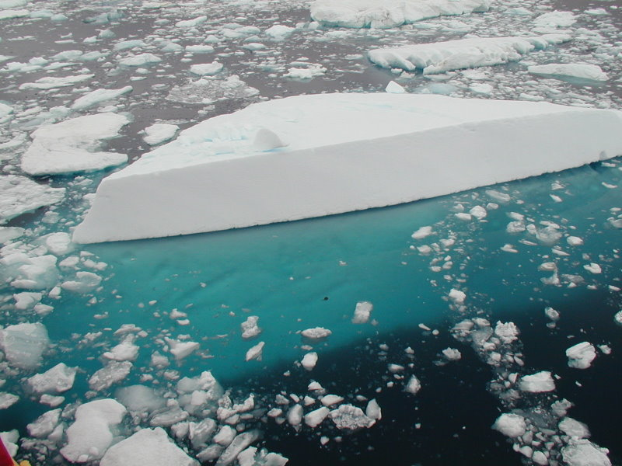
Iceberg with the submerged portion visible. From Geo Swan used under the licensed under the Creative Commons Attribution 2.0 Generic license.

Slide 57
Question 123.5.4
Two cups are filled to the same level with water. One of the two cups has ice cubes floating in it. When the ice cubes melt, in which cup is the level of the water higher?
h
A
B

Slide 58
Question 123.5.5
When a ball is floating on the surface of a pool, how does the force needed to push it under change with depth?
A
F
B
F
B
F_{g}
h
h
h
F
C
h

Slide 59

Question 123.5.6
I have somehow suspended a block of concrete in a fluid. I replace the concrete with a block of Styrofoam with equal volume. The buoyant force on the Styrofoam is
Larger than
smaller than
the same as
The buoyant force on the concrete.

Slide 60
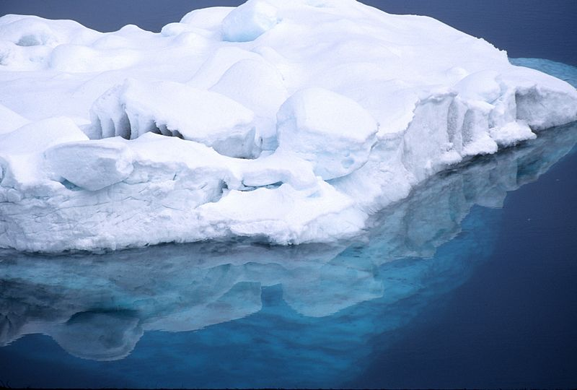

Slide 61
Misplaced Slides

Slide 62
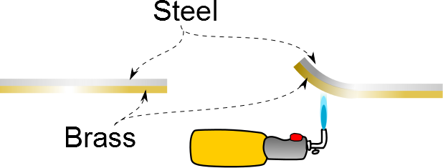

Slide 63
Material | Average α(K⁻¹)
Aluminum | 25×10⁻⁶
Copper | 17×10⁻⁶
Gold | 14×10⁻⁶
Lead | 29×10⁻⁶
Brass | 18.7×10⁻⁶
Steel | 11×10⁻⁶
Glass | 9×10⁻⁶
Concrete | 12×10⁻⁶

Slide 64
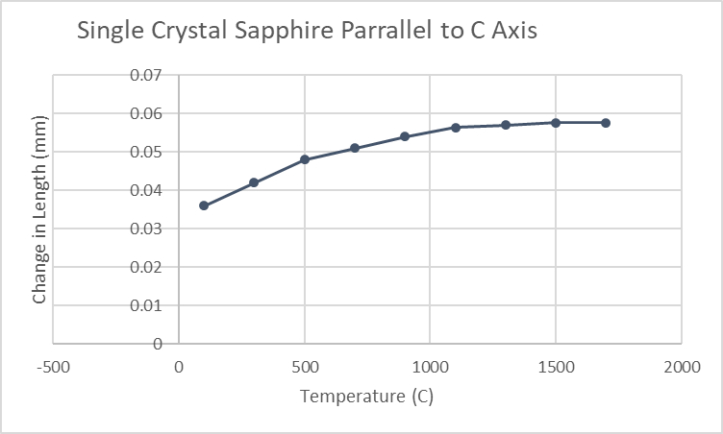

Slide 65
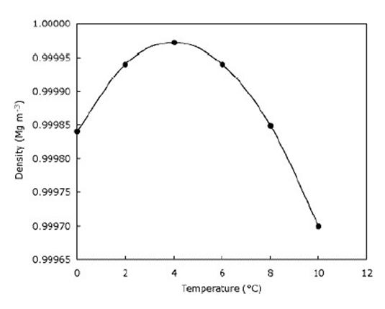

Slide 67

Vacuum
Membrane
Membrane
Gas at T_{i}
Gas at T_{i}

Slide 69
Question 123.9.4
Does the curve fit match the data?
Yes
No

Slide 70
Question 123.9.5
Does the curve fit match the data in the range
-6<x<5?
Yes
No

Slide 71
Question 123.9.6
Could the curve fit in the range
-6<x<5?
be useful?
Yes
No

Slide 73
Question123.9.7 Ideal Gas Law I
Two identical cylinders at the same temperature contain the same gas. If A contains three times as much gas as B, which cylinder has the higher pressure?
1) cylinder A
2) cylinder B
3) both the same
4) it depends on temp. T

Slide 74
Question123.9.5 Ideal Gas Law I
Two identical cylinders at the same temperature contain the same gas. If A contains three times as much gas as B, which cylinder has the higher pressure?
1) cylinder A
2) cylinder B
3) both the same
4) it depends on temp. T
Ideal gas law: PV = nRT
Solve for pressure: P = nRT / V
For constant V and T, the one with more gas (the larger value of n) has the higher pressure P.

Slide 75
Question123.9.8 Ideal Gas Law II
Two identical cylinders at the same pressure contain the same gas. If A contains three times as much gas as B, which cylinder has the higher temperature?
1) cylinder A
2) cylinder B
3) both the same
4) it depends on the pressure P

Slide 76
Question123.9.8 Ideal Gas Law II
Two identical cylinders at the same pressure contain the same gas. If A contains three times as much gas as B, which cylinder has the higher temperature?
1) cylinder A
2) cylinder B
3) both the same
4) it depends on the pressure P
Ideal gas law: PV = nRT
Solve for temperature: T = PV / nR
For constant V and P, the one with less gas (the smaller value of n) has the higher temperature T.

Slide 77
Question123.9.9 Ideal Gas Law III
Two identical cylinders at the same temperature contain the same gas. If B has twice the volume and half the number of moles as A, how does the pressure in B compare with the pressure in A?
1) P_{B} = 1/2 P_{A}
2) P_{B} = 2 P_{A}
3) P_{B} = 1/4 P_{A}
4) P_{B} = 4 P_{A}
4) P_{B} = P_{A}

Slide 78
Question123.9.9 Ideal Gas Law III
Two identical cylinders at the same temperature contain the same gas. If B has twice the volume and half the number of moles as A, how does the pressure in B compare with the pressure in A?
1) P_{B} = 1/2 P_{A}
2) P_{B} = 2 P_{A}
3) P_{B} = 1/4 P_{A}
4) P_{B} = 4 P_{A}
4) P_{B} = P_{A}
Ideal gas law: PV = nRT
Since B has a factor of two more volume, it has a factor of two less pressure. But B also has half the amount of gas, so that is another factor of two reduction in pressure. Thus, B must have only 1/4 the pressure of A.

Slide 79
Question123.9.10 Soda Bottle
A plastic soda bottle is empty and sits out in the sun, heating the air inside. Now you put the cap on tightly and put the bottle in the fridge. What happens to the bottle as it cools?
1) it expands and may burst
2) it does not change
3) it contracts and the sides collapse inward
4) it is too dark in the fridge to tell

Slide 80
Question123.9.10 Soda Bottle
A plastic soda bottle is empty and sits out in the sun, heating the air inside. Now you put the cap on tightly and put the bottle in the fridge. What happens to the bottle as it cools?
1) it expands and may burst
2) it does not change
3) it contracts and the sides collapse inward
4) it is too dark in the fridge to tell
The air inside the bottle is warm, due to heating by the sun. When the bottle is in the fridge, the air cools. As the temperature drops, the pressure in the bottle also drops. Eventually, the pressure inside is sufficiently lower than the pressure outside (atmosphere) to begin to collapse the bottle.

Slide 81
Question123.9.11 Balloon in Freezer
1) it increases
2) it does not change
3) it decreases
What happens to the volume of a balloon if you put it in the freezer?

Slide 82
Question123.9.11 Balloon in Freezer
1) it increases
2) it does not change
3) it decreases
What happens to the volume of a balloon if you put it in the freezer?
According to the Ideal Gas Law, when the temperature is reduced at constant pressure, the volume is reduced as well. The volume of the balloon therefore decreases.
PV
=
nRT
Follow-up: What happens to the volume
when the balloon rises in the air?

Slide 83
Question123.9.7
Your friend has shaken your soda can. The pressure inside has mostly
Increased
Decreased
Stayed the same
Can’t tell

Slide 84
Question 123.9.12
If we go from position A to position B in the PV diagram shown, along the red path, the temperature will
Increase
Decrease
Stay the same
Impossible to tell
B
A

Slide 85
Question 123.9.13
The process shown on this graph is called an
Isobaric process
Isochoric process
Adiabatic process
Isothermal process

Slide 86
Question 123.9.15
I have two pistons filled with gas. In which piston is the pressure higher?
290K
290K
A
B
C Both are the same
D Impossible to tell

Slide 87
Question 123.9.14
The process shown on this graph is called an
Isobaric process
Isochoric process
Adiabatic process
Isothermal process

Slide 88
Question 123.9.15
The process shown on this graph is called an
Isobaric process
Isochoric process
Adiabatic process
Isothermal process

Slide 94
F_{p,air}
F_{p,gas}
F_{g}

Slide 96
A

Slide 97
m

